Slide 1


DataBase Logic in Business Applications
Al.I. Cuza University of Iași
Faculty of Economics and Business Administration
Department of Accounting, Information Systems
and Statistics
Triggers – part II
Updating `computed`/denormalized attributes
By Marin Fotache & Co.

Slide 2
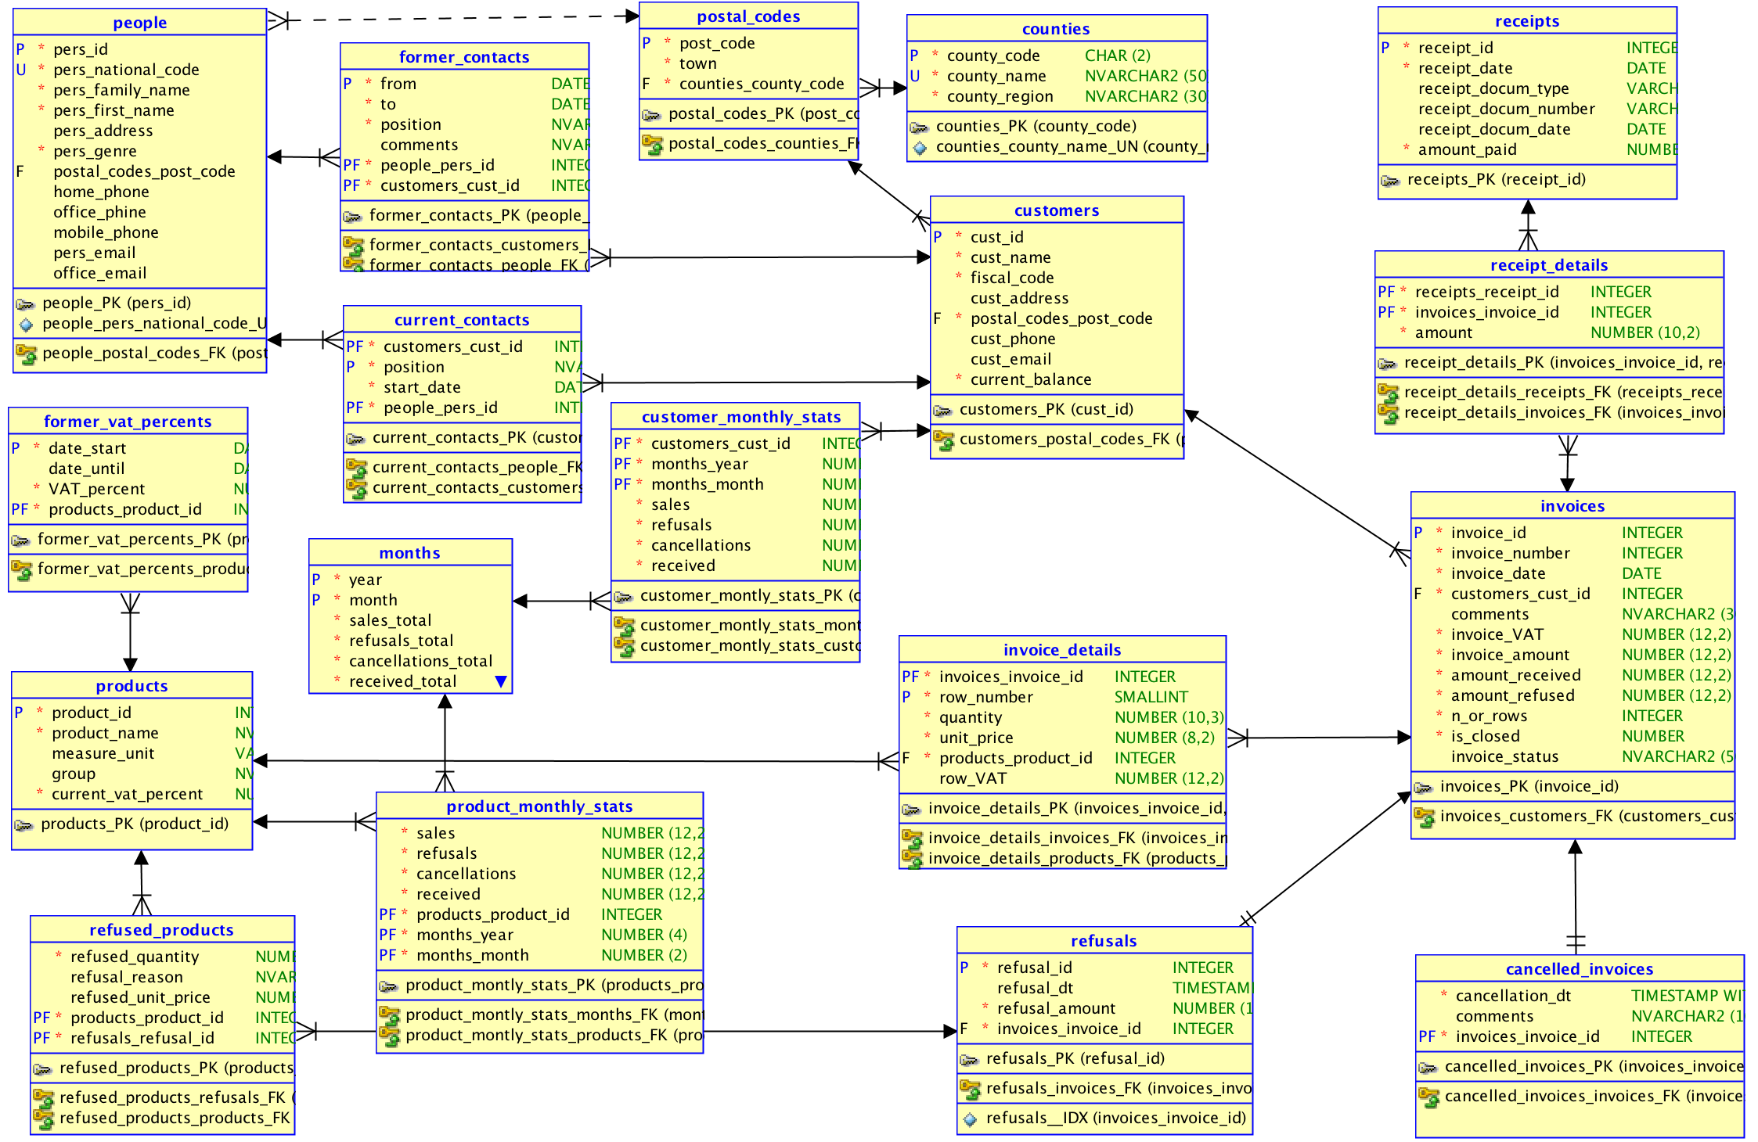
De/Post-Normalized Attributes in sales

Slide 3
Computed (by Triggers) Attributes in sales

Slide 4
Scripts on GitHub
See section 06_Triggers/ of the course:
https://github.com/marinfotache/Database-Logic-in-Business-Applications/tree/master/06_Triggers
Prerequisites (for setting up the database to this point)
06-00-2_fixed_DDL_script_sales_2015.sql
06-00-3_add_constraints_sales_2015.sql
06-01a_en_sequences.sql
06-01b_en_data_cleaning__surrogate_keys.sql
06-01c_en_cascade_updates.sql
Scripts related to this presentation:
06-02a_en_triggers_invoices.sql
06-02b_en_triggers__invoice_details.sql
06-02c_en_triggers__receipts__receipts_details.sql
06-02d_en_proc_auto_ins__receipts.sql
06-02e_en_triggers__refusals__refused_products.sql
06_02f_en_cancellations.sql

Slide 5
Script 06-02a_en_triggers_invoices.sql
Before following/executing the script...
Examine the denormalized attributes in table INVOICES
Identify other denormalized tables and attributes that must be updated/synchronized through table INVOICES’s triggers
Triggers for INSERT in table INVOICES
a. Tasks for the INSERT - BEFORE - ROW trigger
When inserting a new record in table INVOICES, the following of its attributes must be set on 0 (since the invoice has no lines yes):
- INVOICES.invoice_VAT
- INVOICES.invoice_amount
- INVOICES.amount_received
- INVOICES.amount_refused
- INVOICES.n_of_rows
b. Tasks for the INSERT - AFTER - ROW trigger
After inserting a new record in table INVOICES, one must check if this is the first invoice for its month (year + month)
b.1 If no record exists in table MONTHS for current (inserted) invoice's month, then INSERT a record into MONTHS!
b.2 If no record exists in table CUSTOMER_MONTHLY_STATS for current (inserted) invoice's month and customer, then INSERT a record into CUSTOMER_MONTHLY_STATS!
An example of `mutating table` error

Slide 6
Script 06-02a_en_triggers_invoices.sql (cont.)
UPDATE triggers for table INVOICES:
A. test if attribute `invoice_amount` has been changed, but neither `cust_id` nor the year-month of `invoice_date`
A.1 if so, then:
update "CUSTOMERS.current_balance"
update "MONTHS.sales_total"
update "CUSTOMER_MONTHLY_STATS.sales_total"
A.2 if not, do nothing
B. test if the year-month of `invoice_date` or the `cust_id` were changed
B.1 if so, then:
in table CUSTOMERS:
decrease the `current_balance` with `:OLD.invoice_amount` for `:OLD.cust_id`
increase the `current_balance` with `:NEW.invoice_amount` for `:NEW.cust_id`
in table MONTHS:
decrease `sales_total` with `:OLD.invoice_amount` for the old month
increase `sales_total" with `:NEW.invoice_amount` for the new month; (do not forget to check there is a record in MONTHS for the new month)
in table CUSTOMER_MONTHLY_STATS:
decrease `sales_total` with `:OLD.invoice_amount` for the old month and `:OLD.cust_id`
increase `sales_total` with `:NEW.invoice_amount` for the new month and `:NEW.cust_id` (do not forget to check there is a record in CUSTOMER_MONTHLY_STATS for the new month and `:NEW.cust_id`)
test if the year-month of `invoice_date` was changed
B.1.1 if so, then:
in table PRODUCT_MONTHLY_STATS,
decrease `sales` for all products in `:OLD.invoice_id` for the old month
increase `sales` for all products in `:NEW.invoice_id` for the new month
B.1.2 of not, do nothing
B.2 if not, do nothing

Slide 7
Script 06-02a_en_triggers_invoices.sql (cont.)
DELETE triggers for table INVOICES :
BEFORE – ROW:
no tasks
AFTER ROW
update "customers.current_balance"
update "months.sales_total"
update "customer_monthly_stats.sales"
Note: Since payments, refusals and/or cancellations may occur in other months than `invoice_date`’s, with INVOICES triggers we DO NOT update:
”months.refusals_total”
”months. cancellations_total”
“months.received_total"
“customer_monthly_stats.refusals”
“customer_monthly_stats. cancellations”
“customer_monthly_stats.received”
“product_monthly_stats. refusals”
“product_monthly_stats. cancellations”

Slide 8
Script 06-02b_en_triggers__invoice_details.sql
Before following/executing the script...
Examine the computed attributes in table INVOICE_DETAILS
Identify other tables attributes that must be updated/synchronized through INVOICE_DETAILS’s triggers
I. INSERT triggers for table INVOICE_DETAILS
I.a Tasks for the INSERT - BEFORE - ROW trigger
attribute "invoice_details.row_number" must be determined based on attribute "invoices.n_of_rows" for current invoice
attribute "invoice_details.row_vat" must be determined based on attributes "invoice_details.quantity", "invoice_details.unit_price” and "products.current_vat_percent"
I.b Tasks for the INSERT - AFTER - ROW trigger
update "invoice_VAT", "invoice_amount", "n_of_rows" in table INVOICES
update denormalized table PRODUCT_MONTHLY_STATS (if no record exists in table PRODUCT_MONTHLY_STATS for current (inserted) invoice's month and customer invoice row's product, then INSERT a record into PRODUCT_MONTHLY_STATS!

Slide 9
Script 06-02b_en_triggers__invoice_details.sql (cont.)
II. UPDATE triggers for table INVOICE_DETAILS
II.a Tasks for the UPDATE - BEFORE - ROW trigger
check if at least one value of the following attributes was changed: product_vat, `quantity`, `unit_price`; if so, UPDATE `row_vat` !
check if "invoice_details.row_number"'s values has been changed; for the moment, the rule to be enforced is: "the `row_number` cannot be updated, except for the case when also `invoice_id` was changed!"
II.b Tasks for the UPDATE - AFTER - ROW trigger
II.b.1 Check id the `invoice_id` has been changed...
II.b.1.a ...if the "invoice_id" was changed, then...
decrease "invoices.invoice_VAT", "invoices.invoice_amount" and "invoices.n_of_rows" for the OLD invoice
increase "invoices.invoice_VAT", "invoices.invoice_amount" and "invoices.n_of_rows" for the NEW invoice
test if the new invoice date falls in another month
II.b.1.a.1 ... if new line appear in a new invoice placed into another month...
decrease "product_monthly_stats.sales" for the OLD product and the old invoice's month
increase "product_monthly_stats.sales" for the NEW product and the new invoice's month; (do not forget to check if the new product has a corresponding record in "product_monthly_stats" for the current invoice's month (if not, add the record in "product_monthly_stats")
II.b.1.a.2 ... if new line appear in a new invoice placed in the same month...
do nothing
II.b.1.b if the "invoice_id" was not changed, then...
just update "invoices.invoice_VAT" and "invoices.invoice_amount"
II.b.2 Check if the `product_id` has been changed...
II.b.2.a ...if the `product_id` was changed, then...
decrease "product_monthly_stats.sales" for the OLD product (and the current invoice's month)
increase "product_monthly_stats.sales" for the NEW product (and the current invoice's month), but do not forget to check if the new product has a corresponding record in "product_monthly_stats” for the current invoice's month (if not, add the record in "product_monthly_stats")
II.b.2.b if the `product_id` was not changed, then just update "product_monthly_stats.sales"

Slide 10
Script 06-02b_en_triggers__invoice_details.sql (cont.)
III.DELETE triggers for table INVOICE_DETAILS
III.a Tasks for the DELETE - BEFORE - ROW trigger
Nothing to do.
III.b Tasks for the DELETE - AFTER - ROW trigger
Decrease (in table INVOICES):
"invoice_VAT",
"invoice_amount”
"n_of_rows"
for the invoice containing the deleted line/row
Note: The script contains a series of SQL queries (using mainly table expressions) for checking the functionality of all table triggers, i.e. the way the computes attributes synchronize with `base` attributes

